Slide 1
First steps in Java
JAVA
Presentation by Norbert Paksi

Slide 2
Included topics
About programming languages
Create environment
Variables and collections
IF statements
Loops
Functions

Slide 3
About
Programming Languages
In the next slides we will see some basic knowledge about programming languages, and grouping them together.

Slide 4


Slide 5
What is a programming language?
A programming language is a formal language comprising a set of strings that produce various kinds of machine code output. Programming languages are one kind of computer language, and are used in computer programming to implement algorithms.

Slide 6
What is an algorithm?
In the most general sense, an algorithm is a series of instructions telling a computer how to transform a set of facts about the world into useful information. The facts are data, and the useful information is knowledge for people, instructions for machines or input for yet another algorithm.

Slide 7

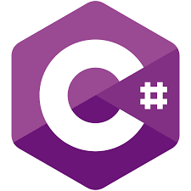

Object oriented ( vs. Procedural)
Java
C#
Python

Slide 8

Backend( vs. Frontend)
Java
PHP
C#

Slide 9
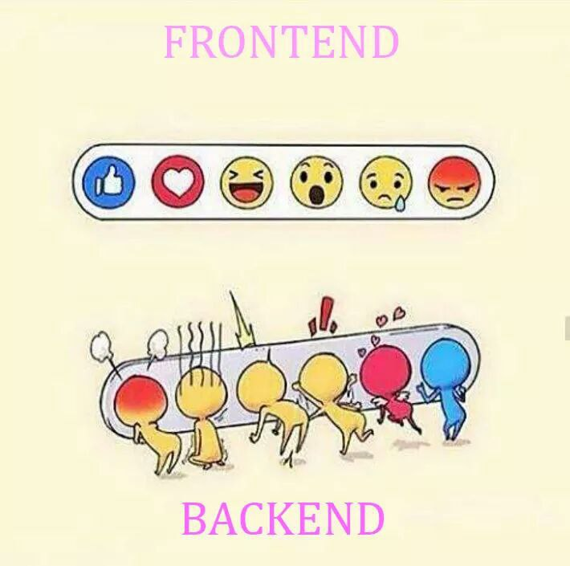
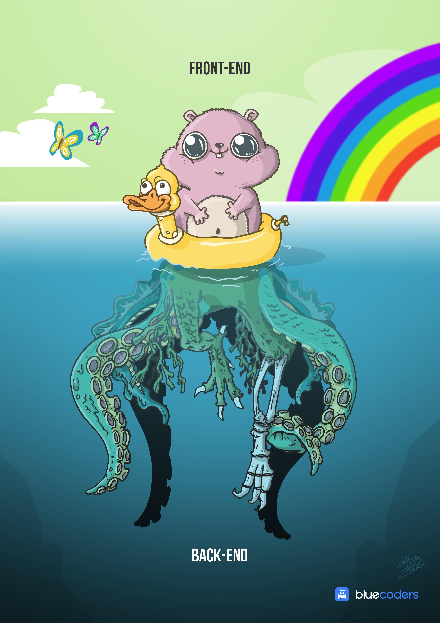

Slide 10
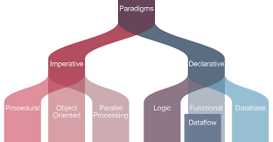
Other grouping possibilities

Slide 11
Java basics
Basics
In the next slides, we will take a look at the building components of Java

Slide 12
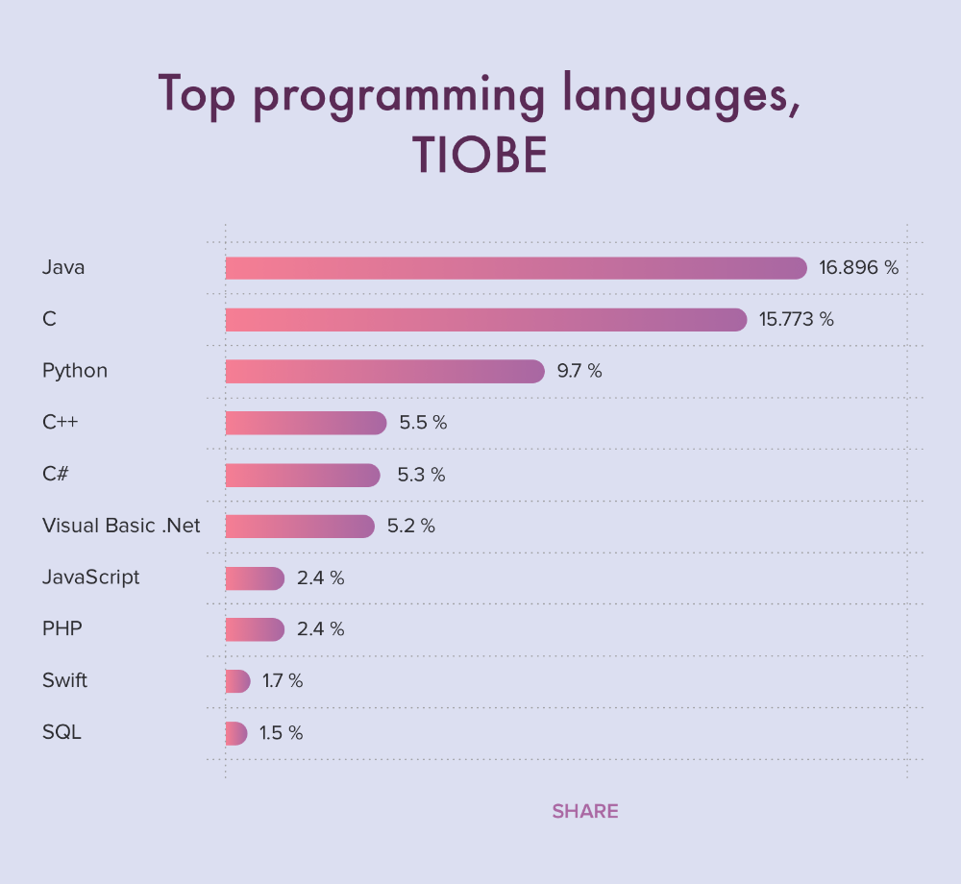
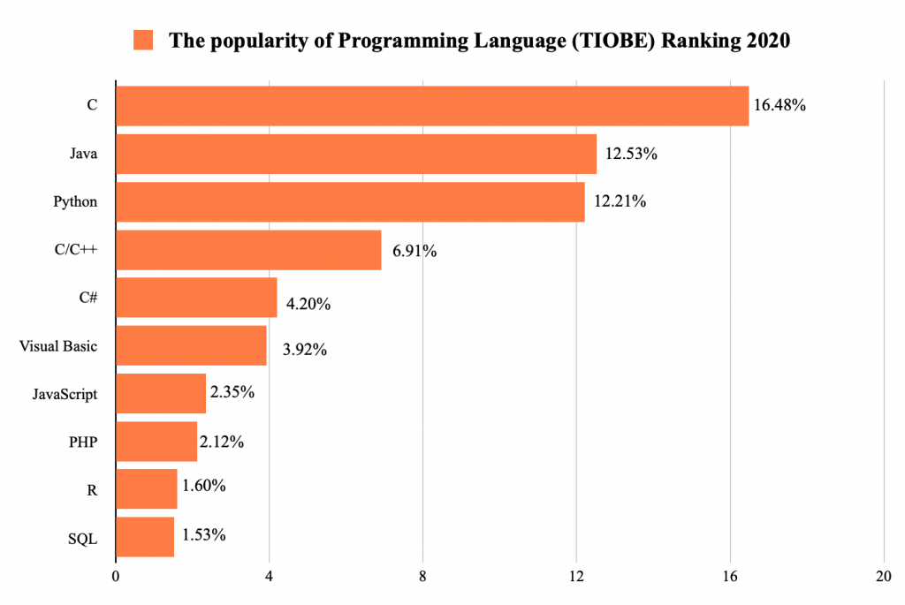
Why Java ?

Slide 13
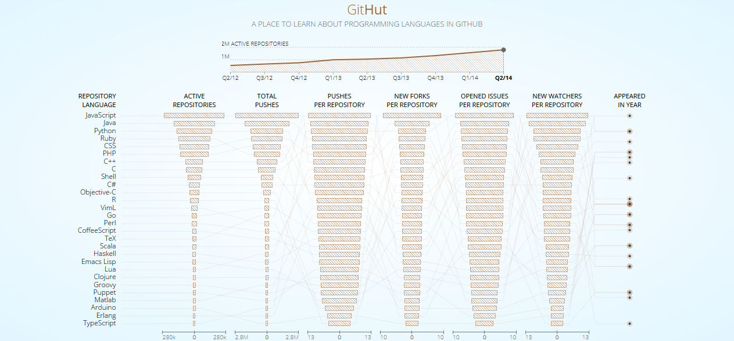

Slide 14
What can you develope?
Web applications
Console applications
Mobile applications
Games

Slide 15
Advantages
Easy to learn
Platform independent
Object oriented

Slide 16
OUR GOALS
JDK
JRE
JVM
JRE
Java developement tools
JVM
Java class library
Virtual Machine

Slide 17
The Java Development Kit (JDK) is a software development environment used for developing Java applications and applets. It includes the Java Runtime Environment (JRE), an interpreter/loader (Java), a compiler (javac), an archiver (jar), a documentation generator (Javadoc) and other tools needed in Java development.

Slide 18






Java program
Operating system
Java
Compiler
JDK
Binary instructions
JVM
Java bytecode

Slide 19
A Java virtual machine (JVM) is a virtual machine that enables a computer to run Java programs as well as programs written in other languages that are also compiled to Java bytecode.

Slide 20
Install Java
Download
Install
Environment variable
Download JDK
Install JDK
Set JAVA-HOME in environment variables
https://www.youtube.com/watch?v=IJ-PJbvJBGs

Slide 21
Environment components
Java
NetBeans
XAMPP
As i mentioned in the previous slide
This will be our IDE for the course
For local servers

Slide 22
THANKS!
This is the end of the lesson, if you have any question, fel free to write me!

Slide 23
Variables
Variables
Data types
Type casting
Variables
Operators

Slide 24
Important fact
Java is a strongly typed programming language because every variable must be declared with a data type. A variable cannot start off life without knowing the range of values it can hold, and once it is declared, the data type of the variable cannot change.

Slide 25

A Java variable is a piece of memory that can contain a data value. A variable thus has a data type. Data types are covered in more detail in the text on Java data types. Variables are typically used to store information which your Java program needs to do its job.

Slide 26
Declarate a variable
Choose datatype
Set value
Add variablename

Slide 27
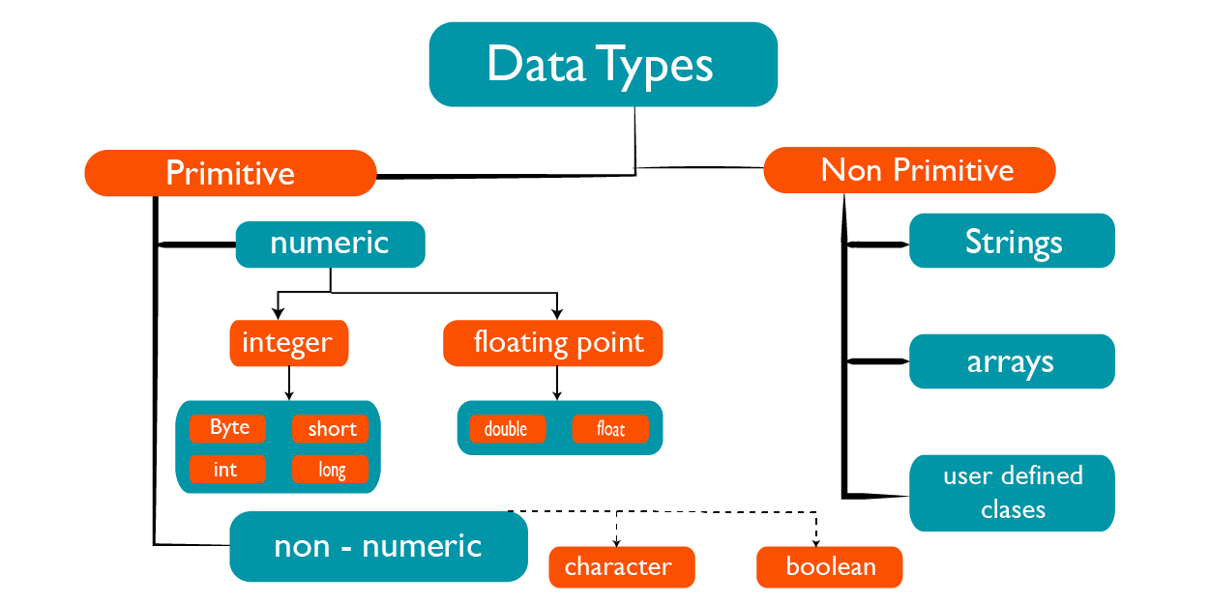

Slide 28
Numeric primitive datatype ranges
byte: -128 to 127
Stored: 1 byte
short: -32768 to 32767
Stored: 2 bytes
int: -2 billion to +2 billion.
Stored: 4 bytes
long: -9 quintilion to 9 quintilion
Stored: 8 bytes

Slide 29
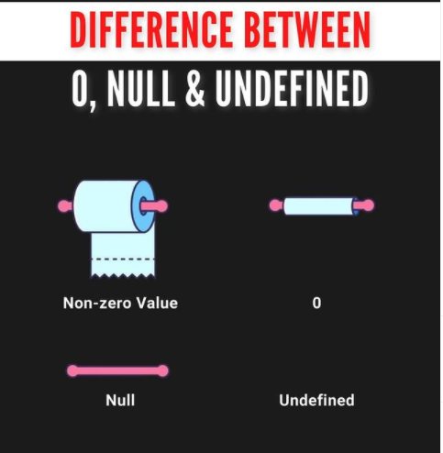
Special states

Slide 30
Reference / Non primitive
Reference
Non primitive datatypes are objects, with a build in background class, contains built in functions and propertyes.

Slide 31
Every primitive datatype has a wrapper class, which is an object based reference type. Wrapper classes named the same, with uppercase starting letter

Slide 32
Object as datatype
Parent class of every other object
Use it if you don’t know the type of your data
Useless as datatype, but typecast can fix the situation

Slide 33
Type casting
Automatic type casting -Implicit
Typecasting, or type conversion, is the process of assigning a primitive data type's value to another primitive data type.
Automatic type casting -Explicit
byte -> short -> int -> long -> float -> double
double -> float -> long -> int -> short -> byte
Definition

Slide 34
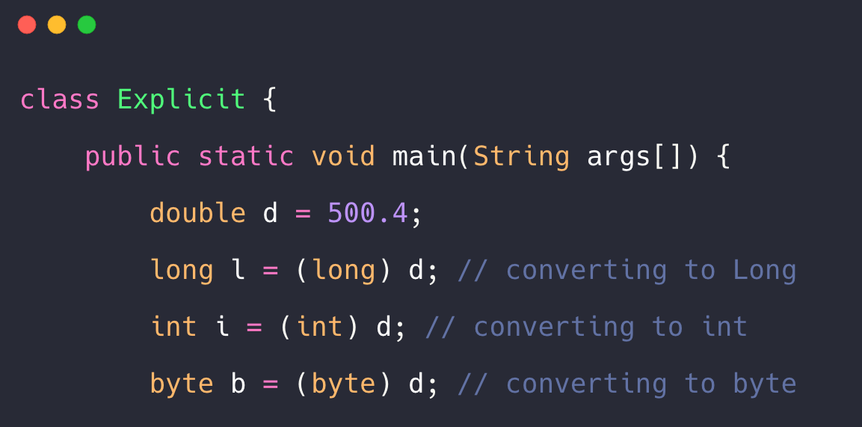

Slide 35
Other options
.toString();
Integer.parseInt();
(int) variablename;

Slide 36
Arritmetical operators
+
-
Addition
Subtraction
*
/
Multiplication
Division
%
++
Modulus
Increment
Adds together two values
Subtract the selcond value from the first
Multiples two values
Divides the first value by the second
Returns the division remainder
Increases the value of a variable by 1
--
Decrement
Decreases the value of a variable by 1

Slide 37
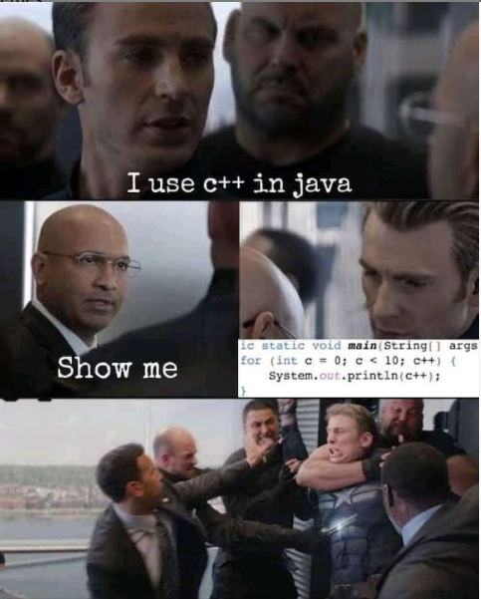

Slide 38
Assignment operators
=
+=
A = 5
A = A +5
-=
*=
A = A - 3
A = A * 3
/=
%=
A = A / 2
A = A % 2
Used for set a value to a variable
Actual value + 5
Actual value - 3
Actual value multiplicated 3 times
Actual value divided by half If a were 5, result will be 2
Actual value divided by half If a were 5, result will be 1

Slide 39
Comparsion operators
==
!=
Equal to
Not equal
X == Y
X != Y
>
<
Greater than
Less than
X > Y
X < Y
>=
<=
Greater than or equal to
Less than or equal to
X >= Y
X <= Y

Slide 40
Collections
Collections
List
Map
Array

Slide 41
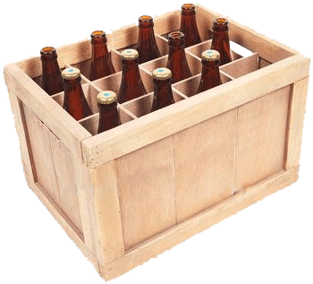
A Collection represents a single unit of objects, i.e., a group. Java Collections can achieve all the operations that you perform on a data such as searching, sorting, insertion, manipulation, and deletion.

Slide 42
Collection types
Array
List
Map

Slide 43
Arrays
Store a fix number of elements in the same type
Container object with built in functions
Automatical indexing started by 0

Slide 44
More possibilities
Multidimensional
Declarated empty
Filled while declaration
Multidimensional arrays contains other arrays, as elements
You can declarate a technically empty array, but in real, it will be filled with null values

Slide 45
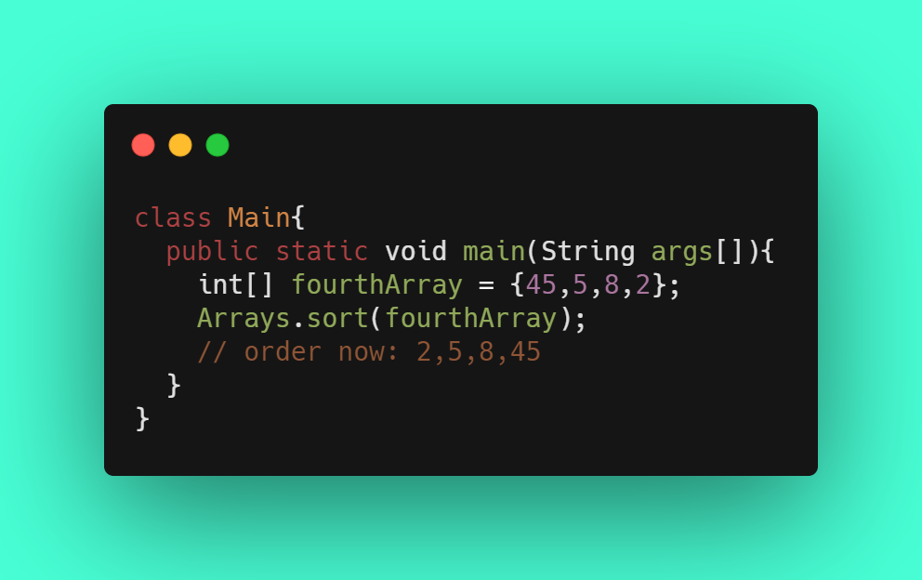
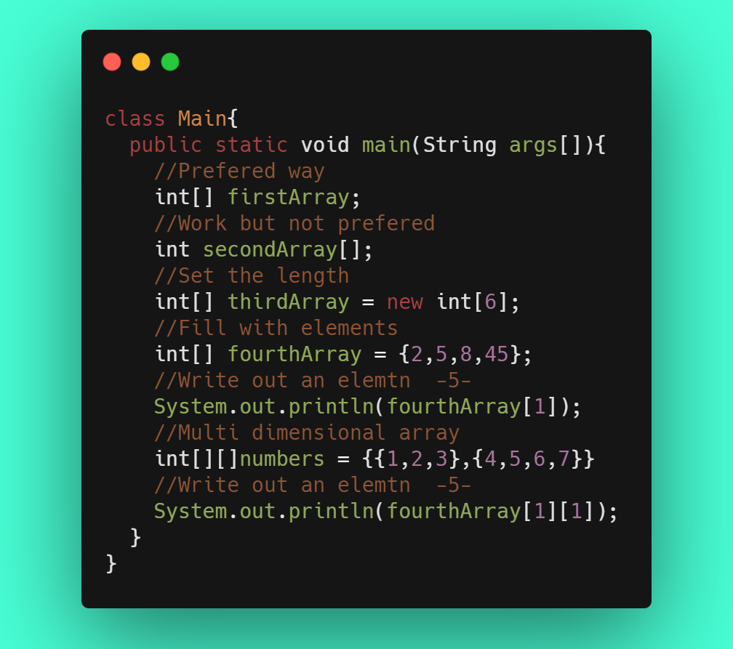

Slide 46
Lists
Resizeable
True remove
ArrayList and LinkedList

Slide 47
Java List is an interface that extends Collection interface. Java List provides control over the position where you can insert an element. You can access elements by their index and also search elements in the list.

Slide 48
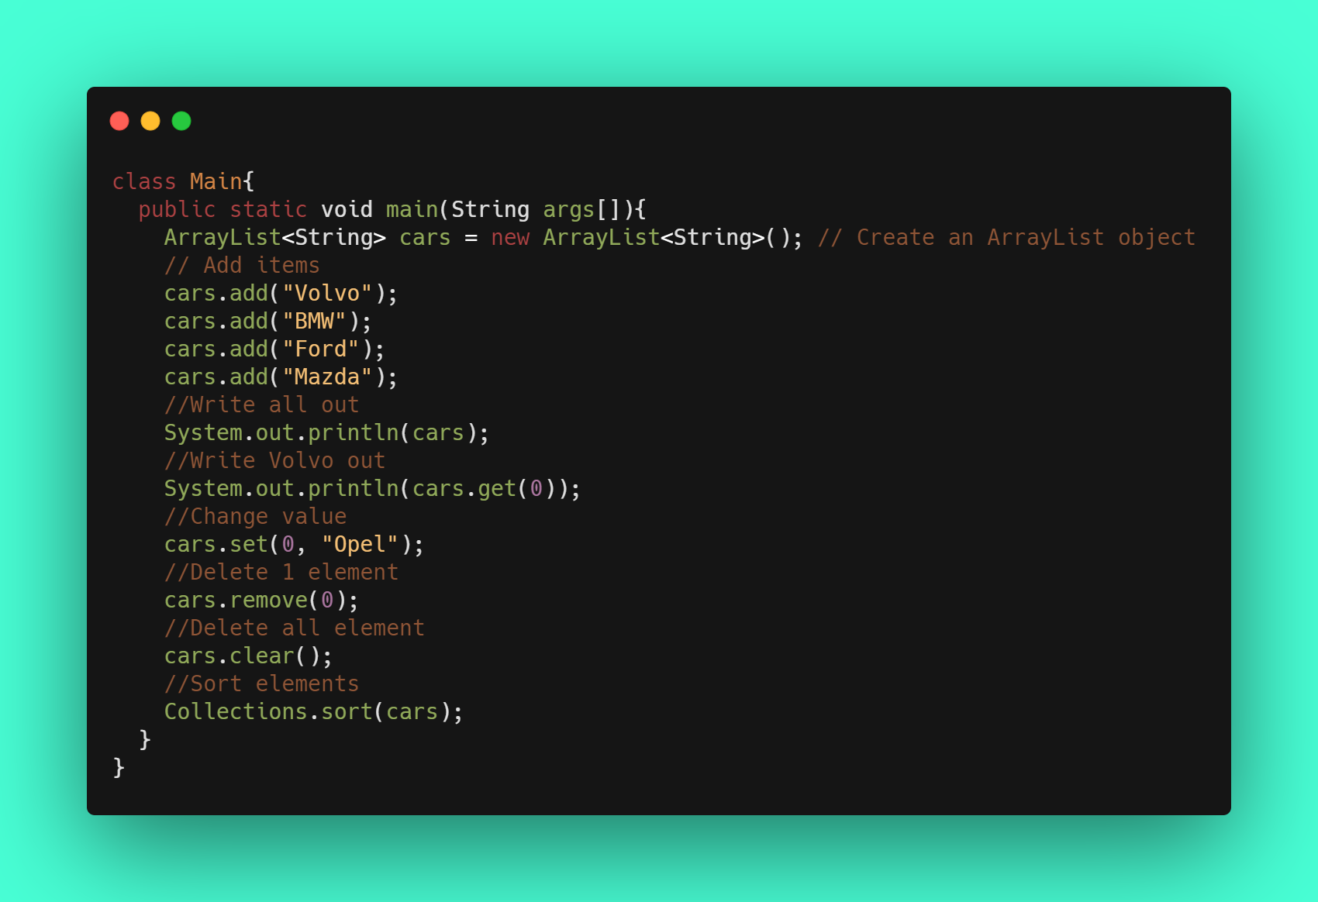

Slide 49
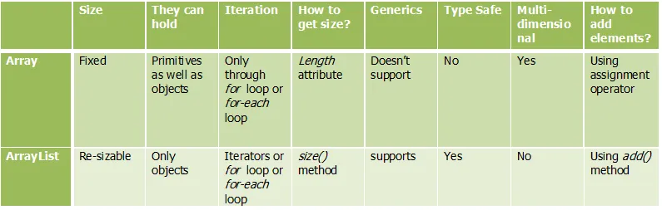

Slide 50
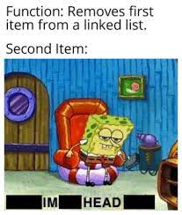
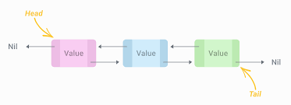
Linked List

Slide 51
ABOUT MAPS
A map contains values on the basis of key, i.e. key and value pair. Each key and value pair is known as an entry. A Map contains unique keys.
A Map is useful if you have to search, update or delete elements on the basis of a key.

Slide 52
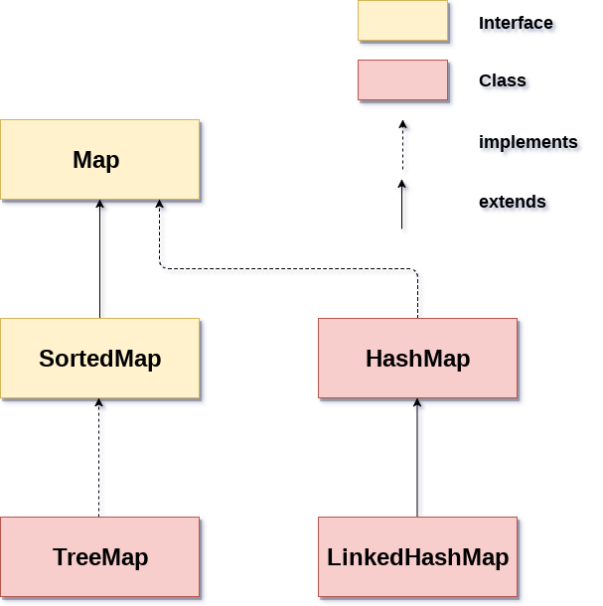
HashMap
LinkedHashMap
TreeMap
HashMap is the implementation of Map, but it doesn't maintain any order.
LinkedHashMap is the implementation of Map. It inherits HashMap class. It maintains insertion order.
TreeMap is the implementation of Map and SortedMap. It maintains ascending order.

Slide 53
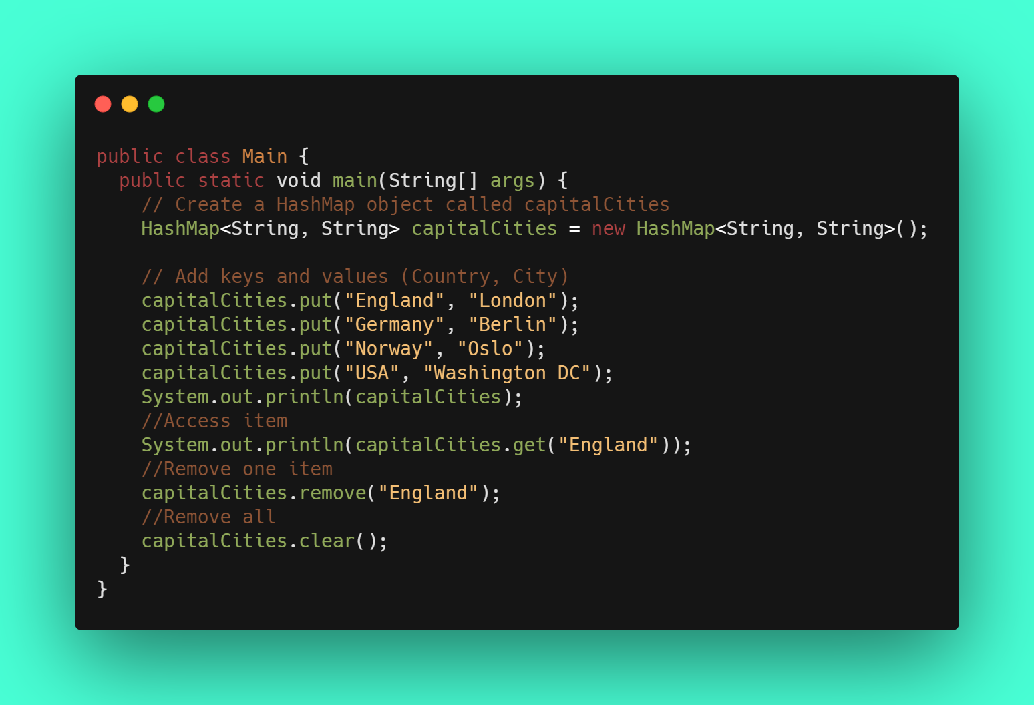

Slide 54
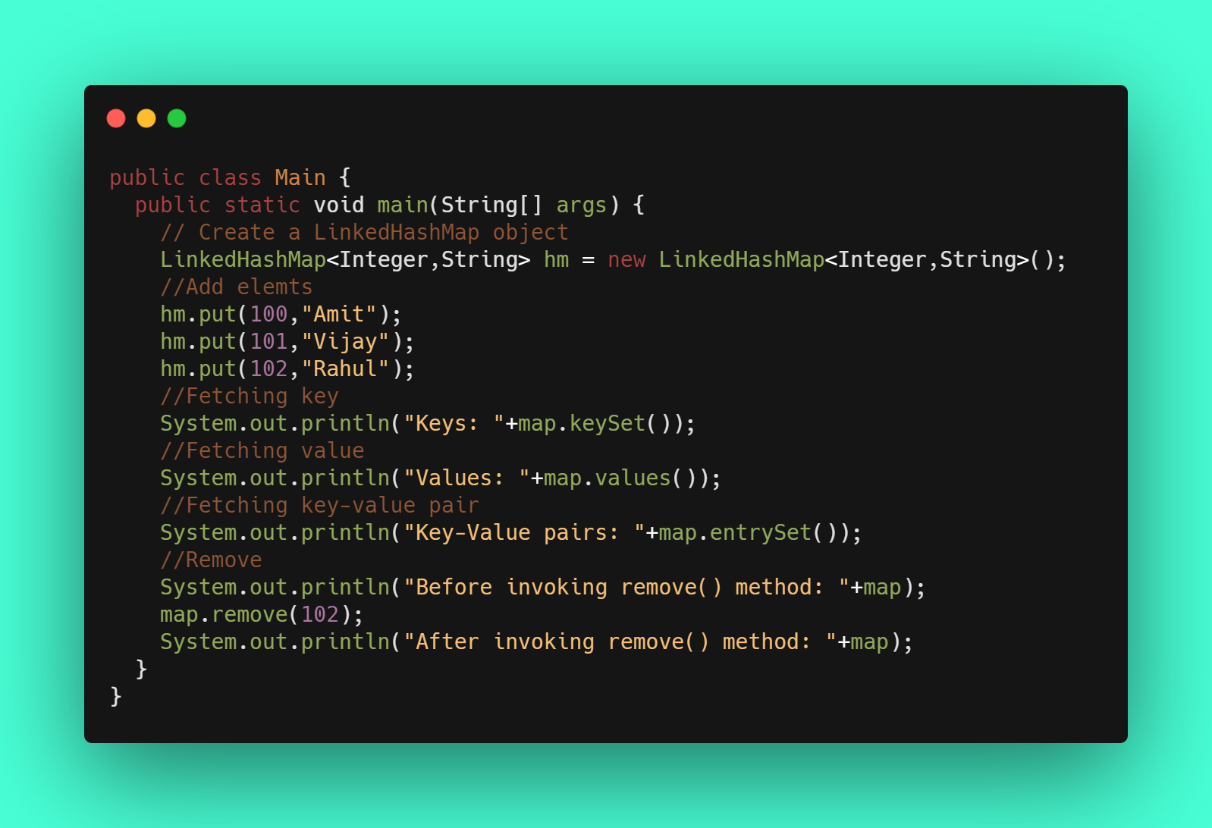

Slide 55
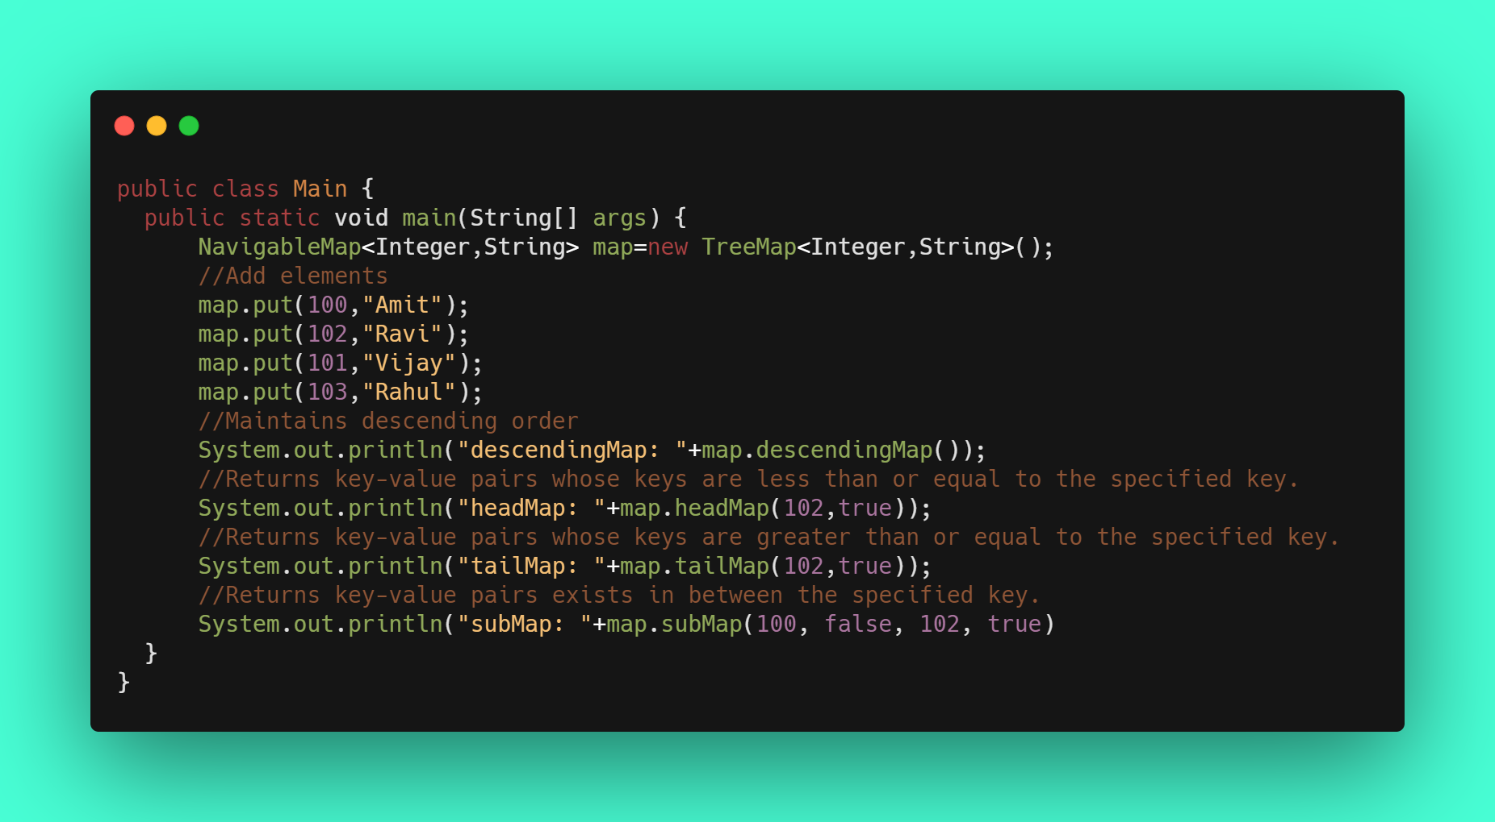

Slide 56
THANKS!
This is the end of the lesson, if you have any question, fel free to write me!

Slide 57
Logical statements
Variables
Statements
Conditions
Ternary operator
Switch

Slide 58
The IF statement is a decision-making statement that guides a program to make decisions based on specified criteria. The IF statement executes one set of code if a specified condition is met (TRUE) or another set of code evaluates to FALSE.

Slide 59
What can you develope?
Use IF to specify a block of code to be executed, if specified contidion is true
Use ELSE to specify a block of code to be executed, if the same contidion is false
Use ELSE IF to specify a block of code to be executed, if first contidion is false
Use SWITCH to specify many alternative blocks of code to be executed

Slide 60
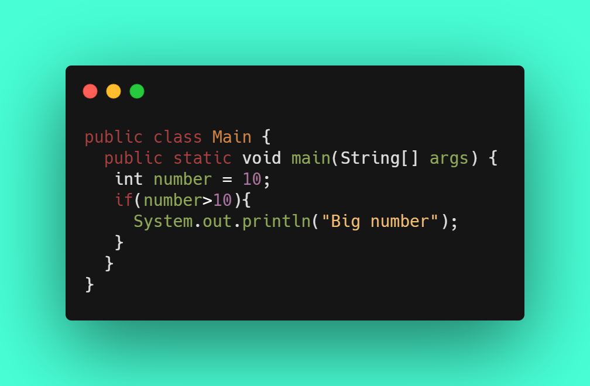

Slide 61
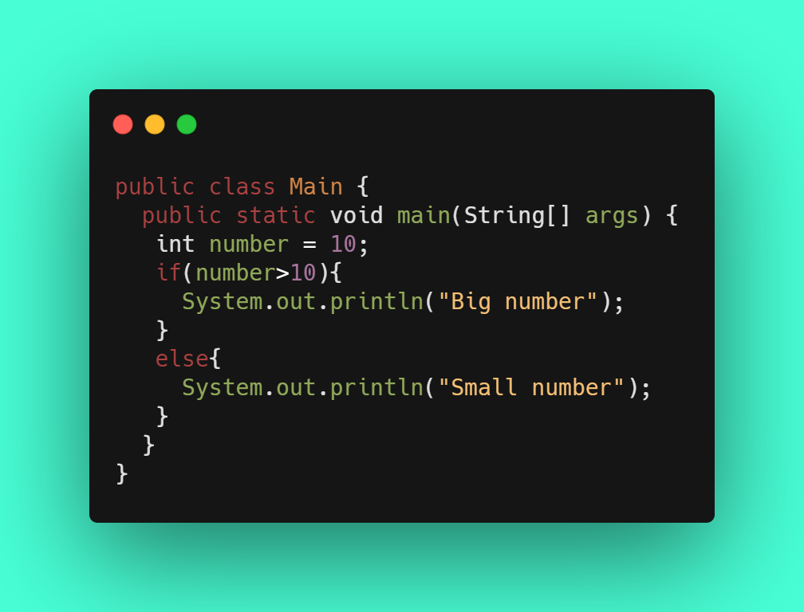
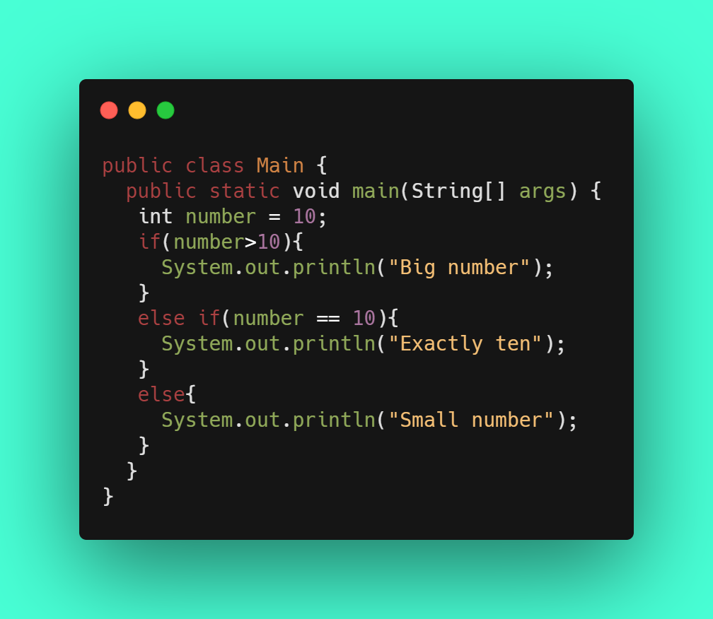

Slide 62
Order of conditions
The statement wil lcheck the conditions one by one, while it find the first true result. To keep this condition checking low, you should priorise your conditions according to probability. You should put the most possible condition to the IF statement, and so on.

Slide 63
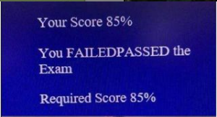
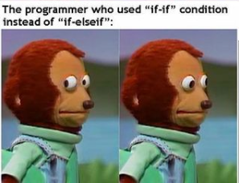
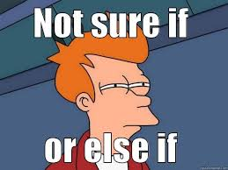

Slide 64
Combine conditions together
&&
||
!

Slide 65
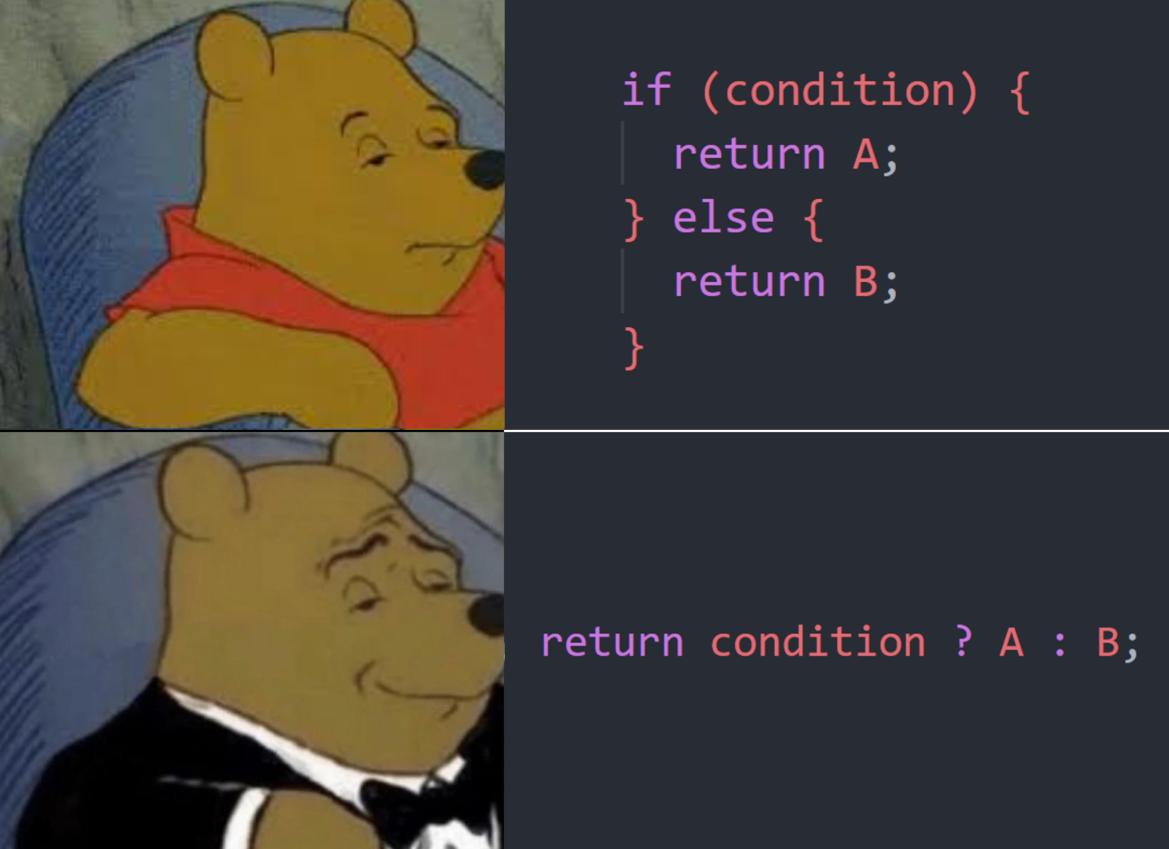

Slide 66
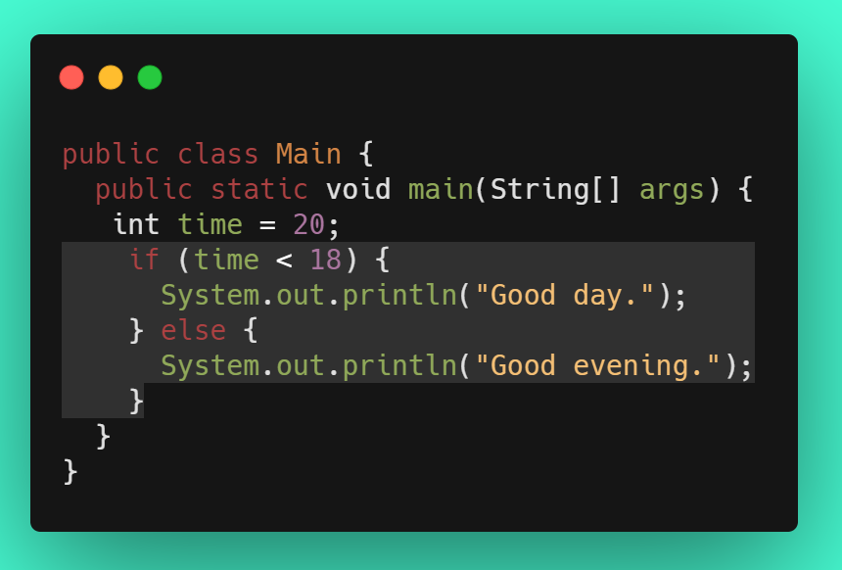
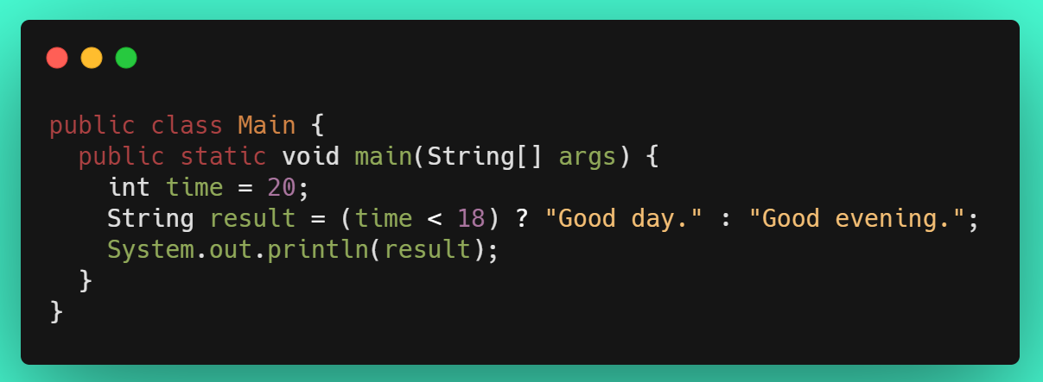
Ternary operator

Slide 67
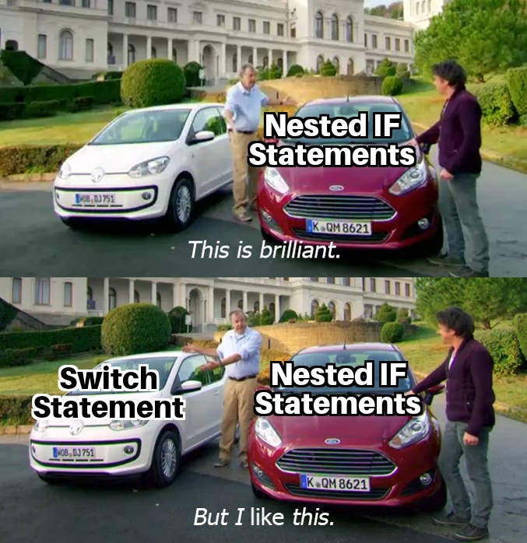

Slide 68
This is how it works:
SWITCH
This switch expression is evaluated once.
The value of the expression is compared with the values of each case.
If there is a match, the associated block of code is executed.
The break and default keywords are optional, and will be described later in this chapter

Slide 69
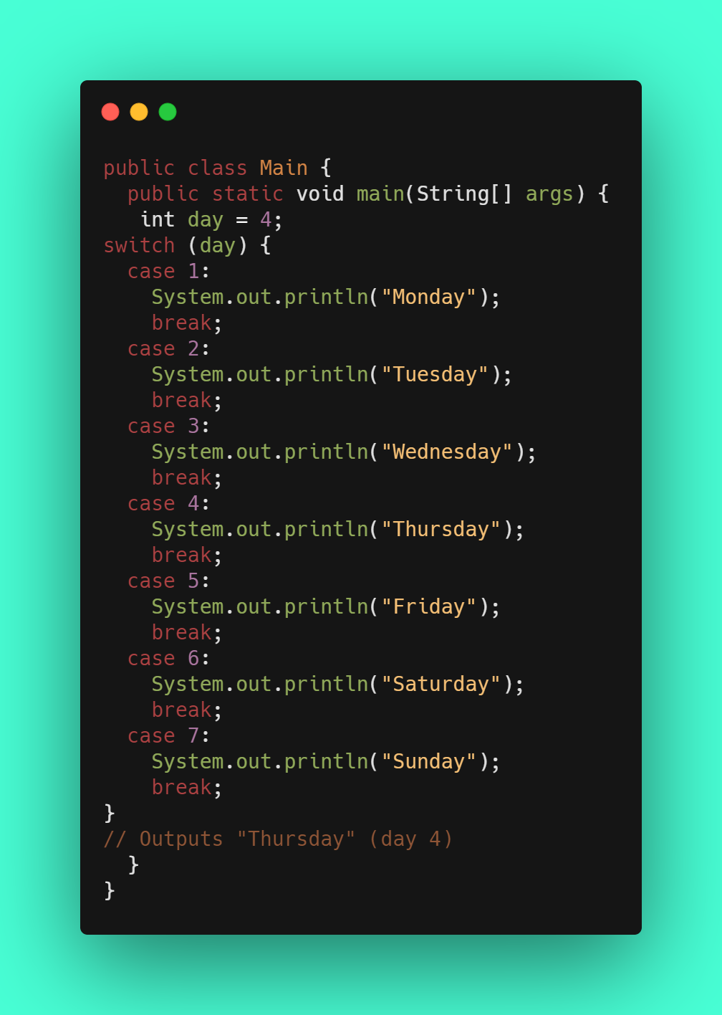
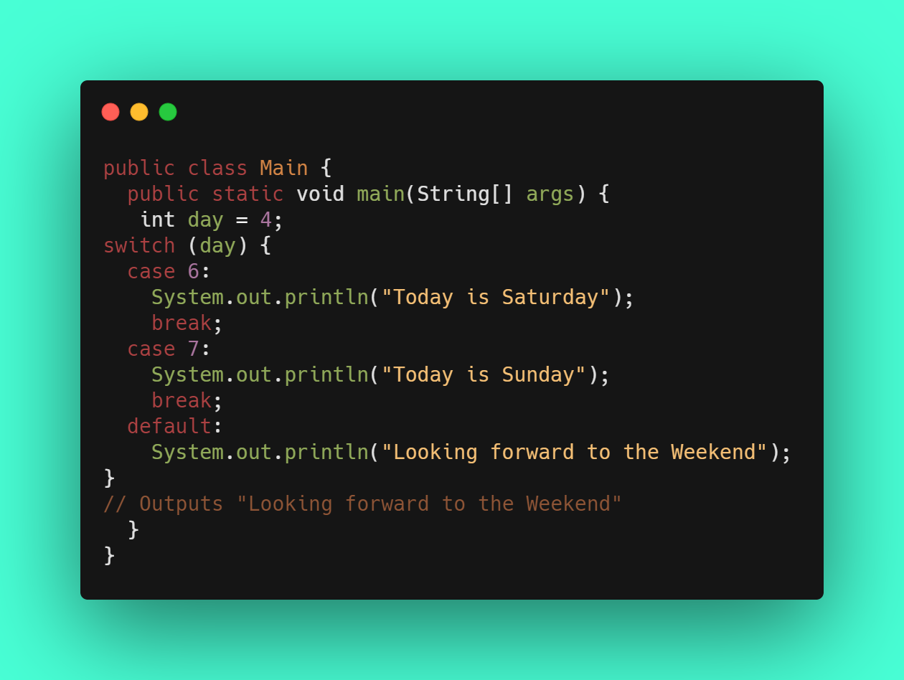

Slide 70
THANKS!
This is the end of the lesson, if you have any question, fel free to write me!

Slide 71
LOOPS

Slide 72
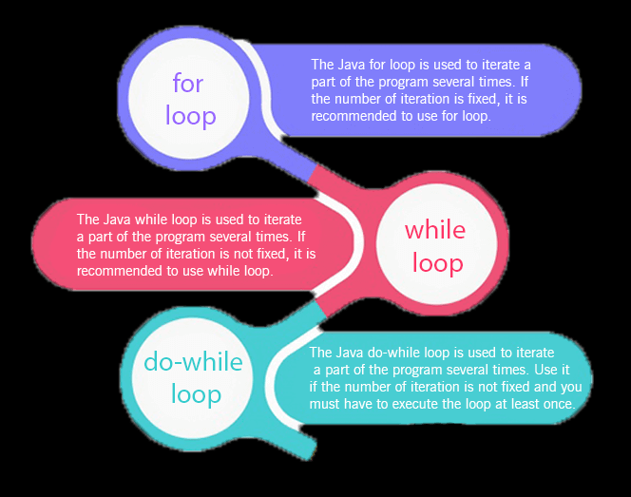
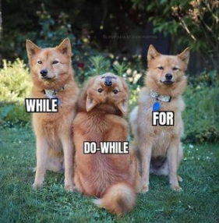
LOOPS

Slide 73
FOR LOOP
Statement 1
Statement 2
Statement 3
is executed (one time) before the execution of the code block.
defines the condition for executing the code block.
is executed (every time) after the code block has been executed.

Slide 74
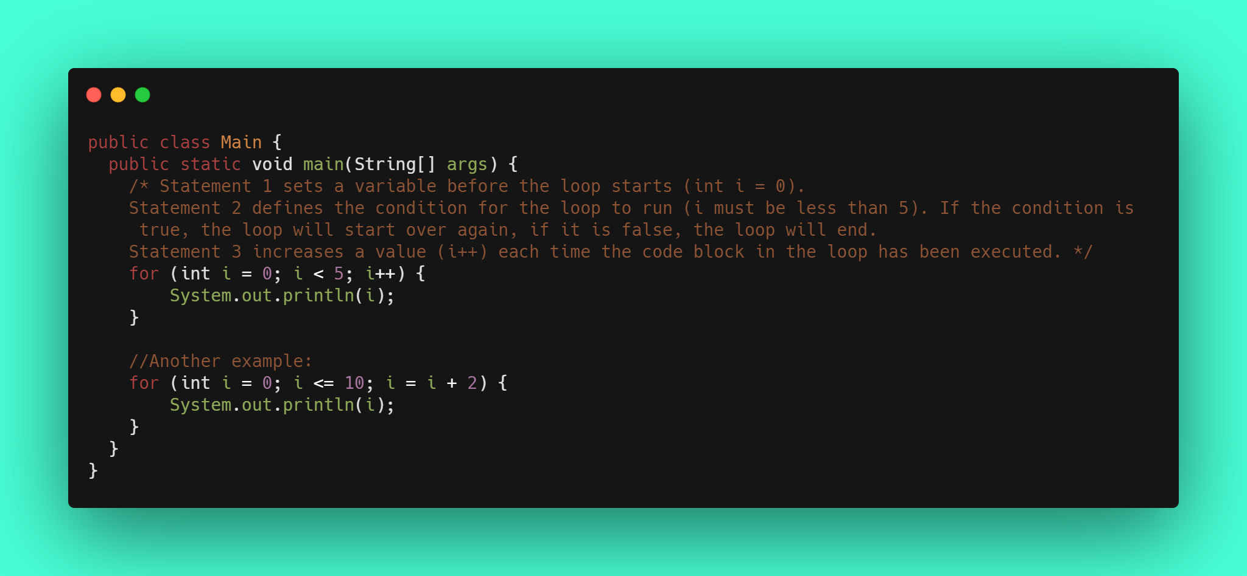

Slide 75
WHILE
Outside loop vairable
Condition
Inside loop variable changeing

Slide 76
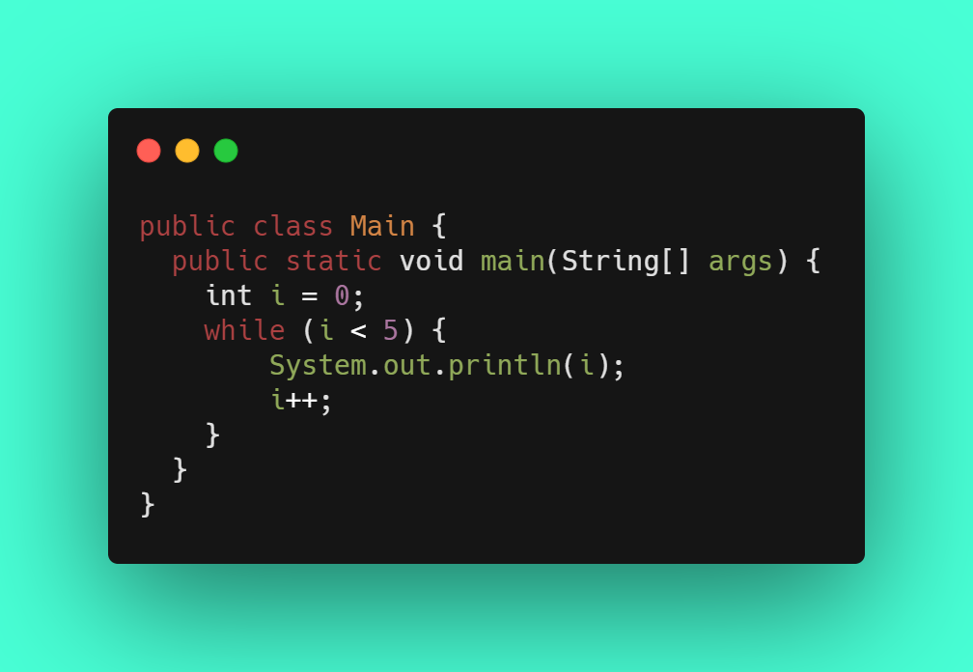
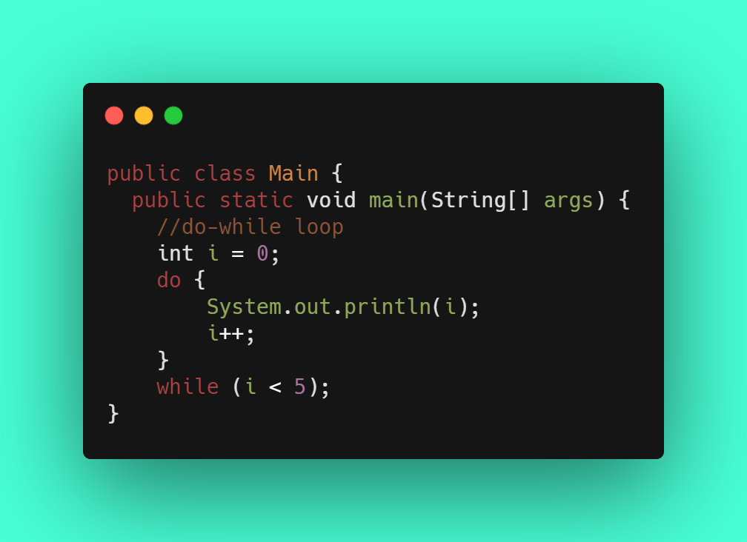

Slide 77
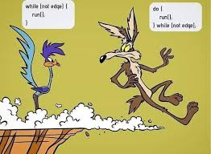
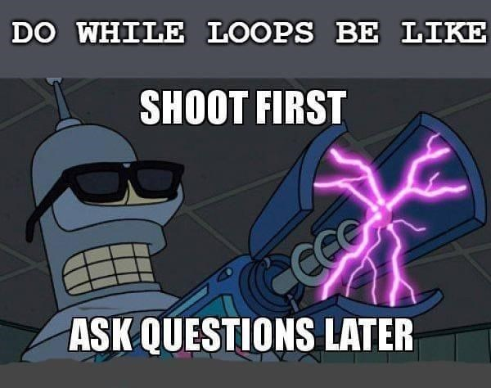

Slide 78
Foreach loop (or for each loop) is a control flow statement for traversing items in a collection. Foreach is usually used in place of a standard for loop statement. ... The foreach statement in some languages has some defined order, processing each item in the collection from the first to the last.

Slide 79
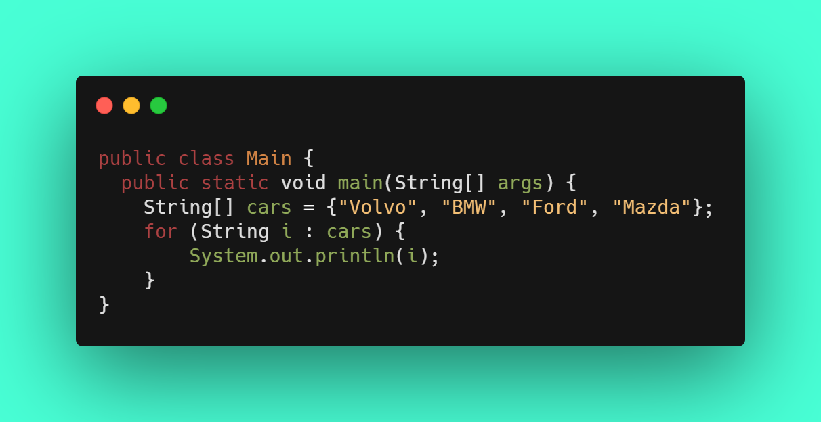
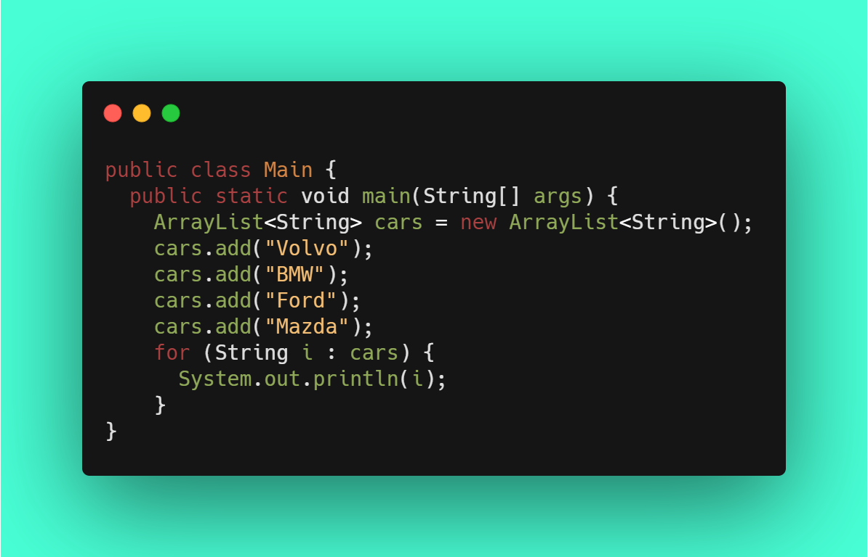

Slide 80
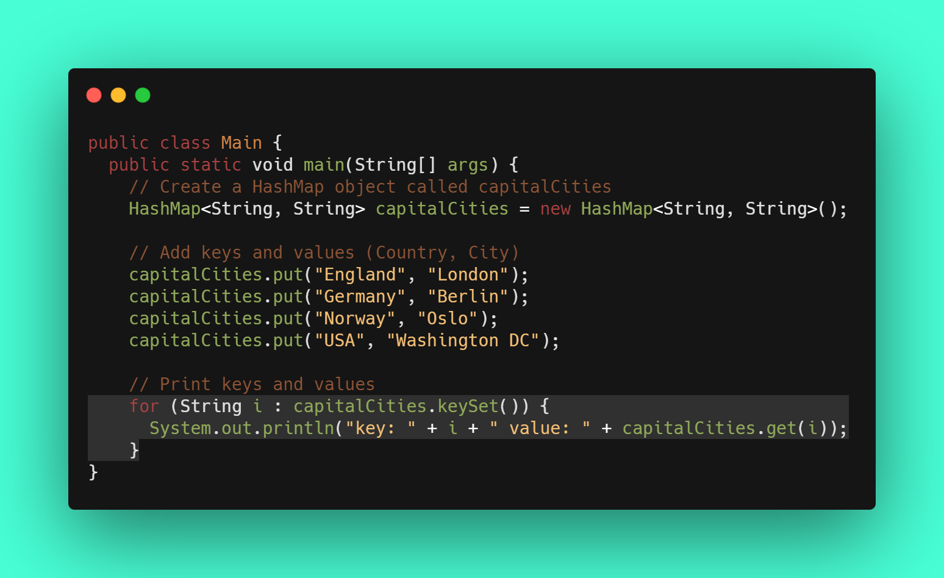

Slide 81
THANKS!
This is the end of the lesson, if you have any question, fel free to write me!

Slide 82
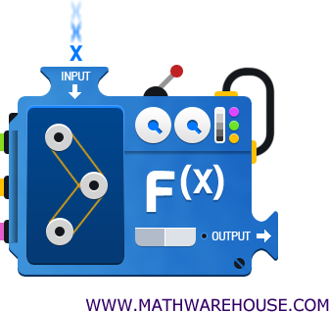
Functions

Slide 83

With return or without return

Slide 84
Main parts
Input parameter
Function body
Return value

Slide 85
Declaration
Visibility
Return type
Function name ( input parameters)
Body
Public
int
MyFunction( int param)
Definition of actual function

Slide 86
Polymorphism means "many forms", and it occurs when we have many classes that are related to each other by inheritance. Polymorphism uses those methods to perform different tasks. ... This allows us to perform a single action in different ways.

Slide 87
Polymorphism
Different amount of input parameters, same function name.
Different type of input parameters, same function name

Slide 88
Advantages
Reuseable code
Transparent
Professional

Slide 89
THANKS!
This is the end of the lesson, if you have any question, fel free to write me!

